Slide 1



Tagging via Content & Standards
Team Data Bees
Supporting MITRE Corporation

Slide 2







Team Data Bees
Shagufta Hassan
Developer
Madesh
Scrum Master
Lama Alznaidi
Product Owner
Prajna Shetty
Developer
Durafshan Jawad
Lead Developer

Slide 3
AGENDA
1
Introduction
2
Data Acquisition & Cleaning
3
Keyword Extraction & Exploration
Data Modeling & Evaluating
4
Data Modeling & Evaluating
5
Conclusion, Lesson Learnt & Next Steps
3

Slide 4
1
Introduction

Slide 5
PARTNERS
Who's MITRE?
MITRE helps the government through
Knowledge integration & research capabilities.
What's MITRE UIX program?
MITRE UIX aims to accelerate the development of innovative helps approaches to tackling major societal challenges.
Our partnership with MITRE?
To strengthen MITRE's longstanding academic partnerships and to support its mission to solve problems for a safer world.
Our problem to solve with MITRE?
Automating tagging via content and standards.
Partners
Dr. Randy Howard
Nick Pesce
Chris Basel
Heather Whittaker
Bonnie O’Neil
Brianna Salameh
Toni Corbett
5

Slide 6
PROBLEM description
Team Data Bees, Fall 2022
Tagging via content and Standards
5 news article datasets
Scale
Topic modeling, LDA with Gensim
Predictive approach
Python model, model visualization
Deliverables
6

Slide 7
PROJECT goal
To extract metadata tags from text datasets
Meta Data
Build an ML model to identify the best descriptor for the dataset
Data Tagging
Organize datasets based on admin and descriptor tags for a data catalog
Data Catalog
7
7

Slide 8


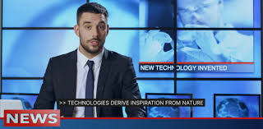


Problem Statement
With ever-growing digital content, it is hard to keep the practice of tagging manually and arbitrarily.
Maintaining a gold standard to enable interoperability
To automate the process of organizing the organization’s inventory of data assets with standard and structured tags.
Creating a baseline standard for tagging content referring to DCAT vocabulary.
8
8
Notes:
.

Slide 9
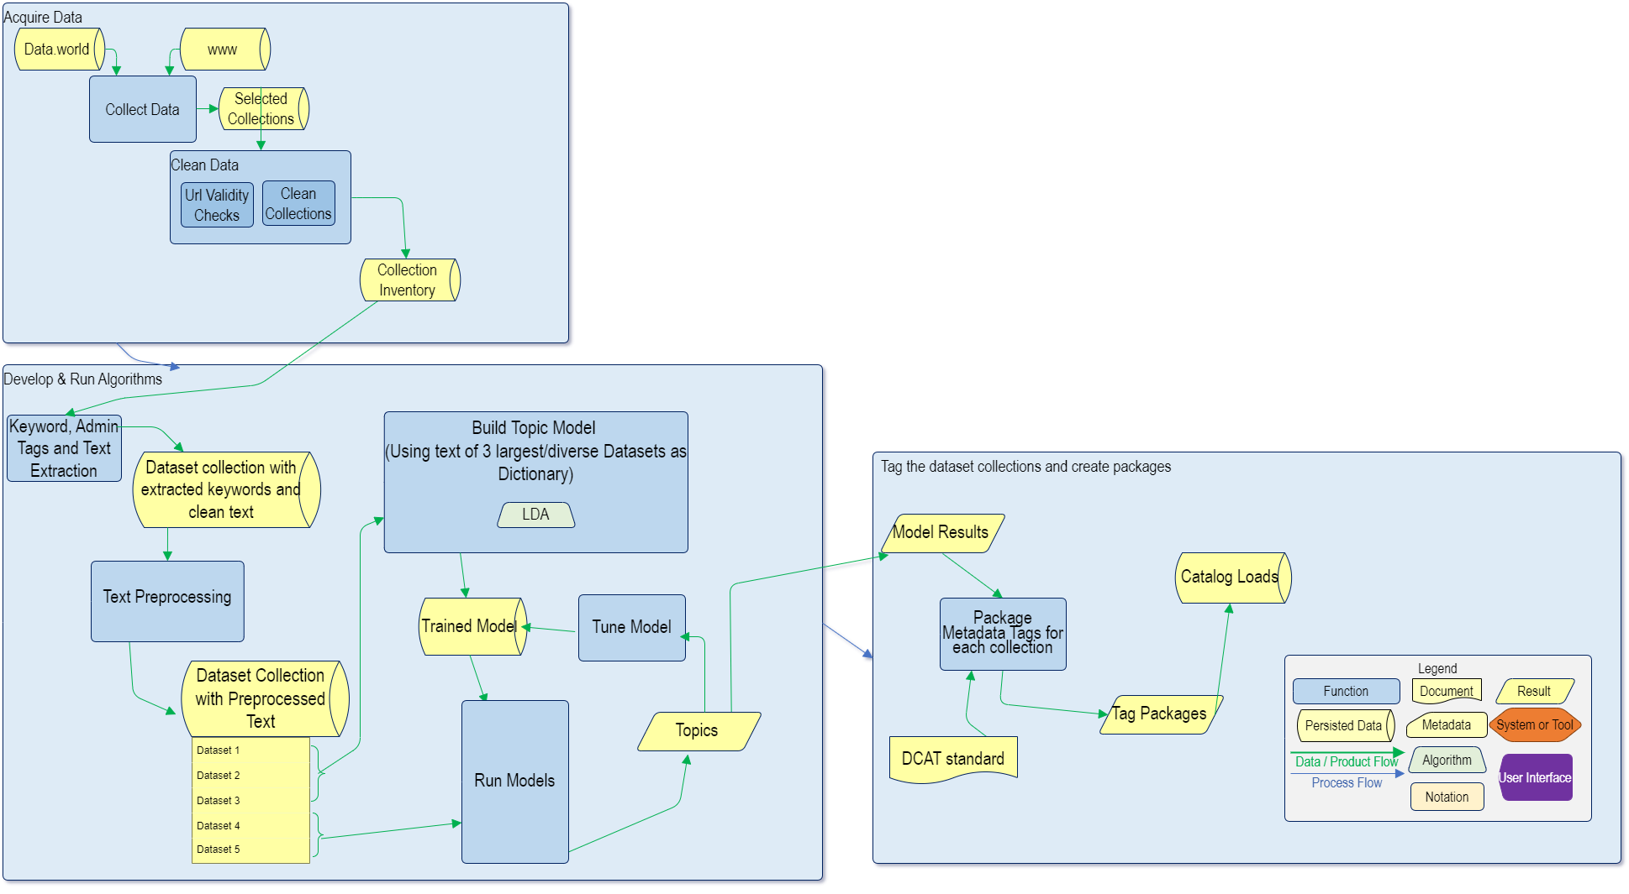
Functional Flow of Final Solution
9

Slide 10
2
DATA Acquisition & CLEANING

Slide 11


Data INVENTORY
BBC UK News
BBC is responsible for the gathering and broadcasting of news and current affairs in the UK.
01
Al Jazeera English News
02
Al Jazeera English News Is an international English-language television broadcaster.
03
CNBC News
CNBC is a business and financial news dataset
04
The Japan Times news
The Japan Times news datasets feature the news from Japan and ASIA Pacific
05
CNN News
The Cable News Network is a multinational news-based pay television channel
06
11

Slide 12
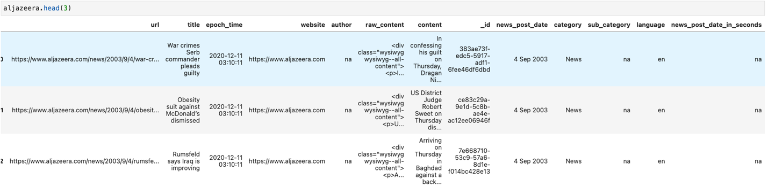
Data INVENTORY
Al Jazeera English News Dataset
Each URL leads to the webpage of a particular article on the publisher's website, where all the information displayed on that page can be retrieved.
06
12

Slide 13
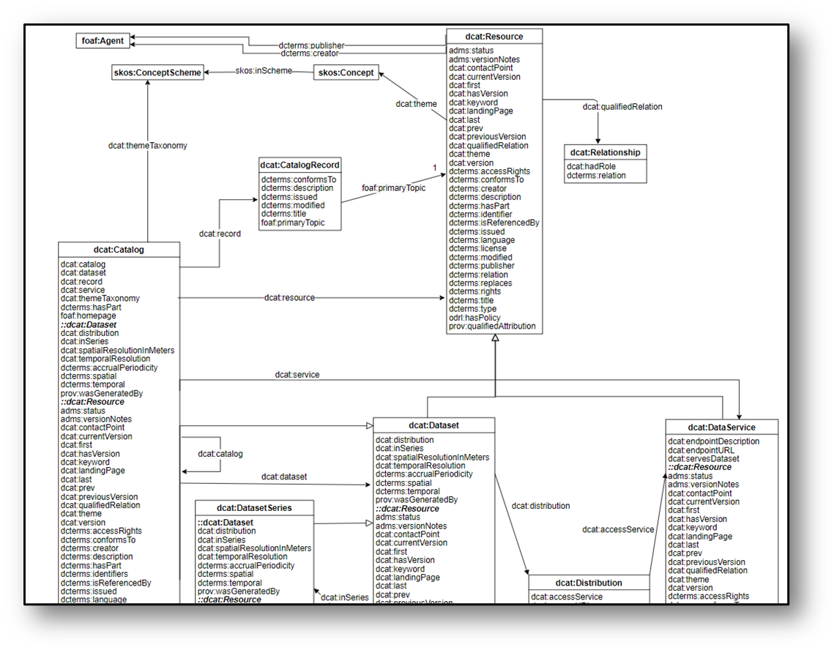

Data Catalog Vocabulary (DCAT) - Version 3
https://www.w3.org/TR/vocab-dcat-3/
13

Slide 14

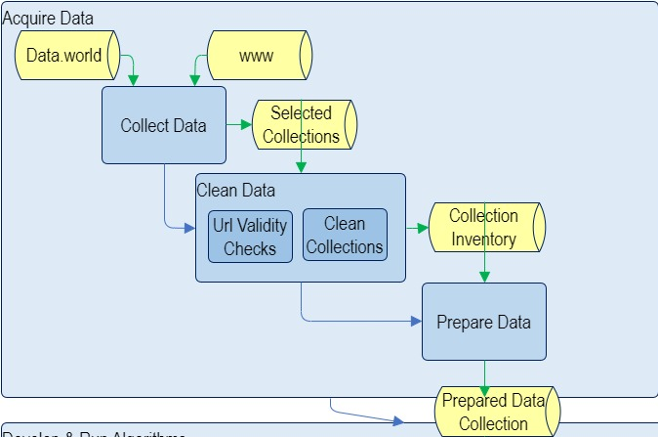
Data Cleaning
Schematic Flow
14

Slide 15
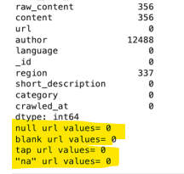
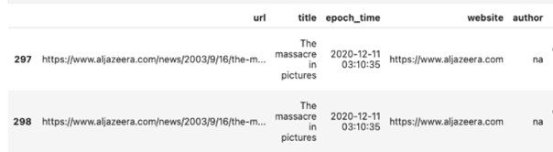
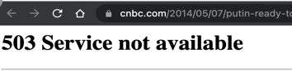
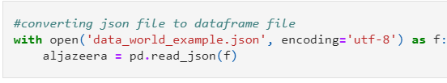
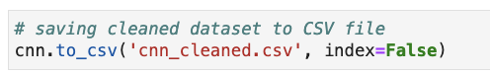


Data Cleaning
Functionality
Output
Null/Missing Values validation check
Removed ‘empty cells’, ‘white spaces’, & ‘na’ strings
Data Duplicity Check
Remove all the duplicate entries
Validity of URLs Check
Remove all the invalid URLs
Data Consistency Check
Created a uniform CSV format to maintain consistency
15
15

Slide 16
3
KEYWORD EXTRACTION

Slide 17
KEYWORD extraction
Schematic Flow
Topic Modelling LA
17

Slide 18
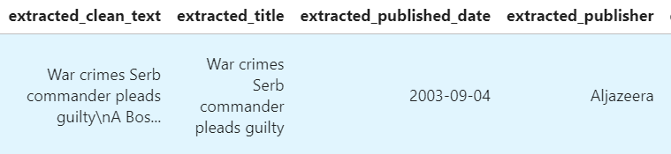
KEYWORD extraction
Clean Text, Title, Published Date & Publisher from the URL
18

Slide 19
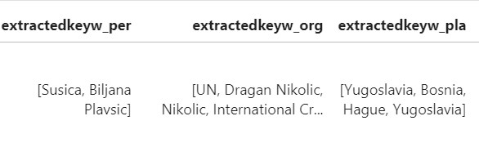
KEYWORD extraction
Entity Tags – Person, Organization and Location from the clean text
19

Slide 20
Text Preprocessing
Schematic Flow
20

Slide 21
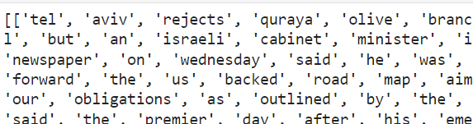
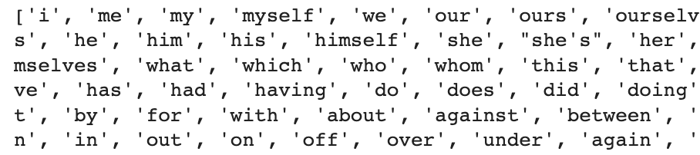
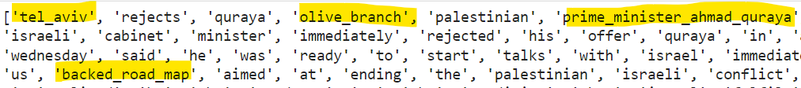
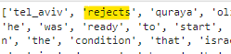

Text Preprocessing
Functionality
Output
Tokenization
Convert sentences to a list
of words
Stop words
Removing
Remove the, is, and,
etc..
Bigrams and trigrams creation
Two & three most frequently occurring words together
Lemmatization
Reduce words to their root word
21

Slide 22
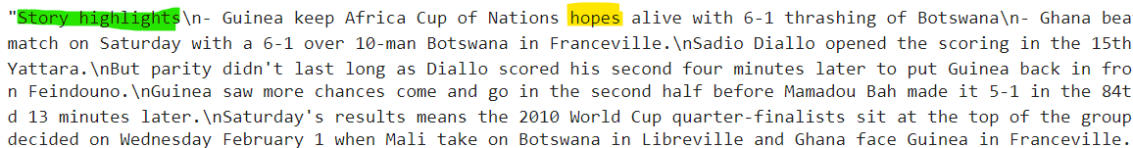

Data before & after preprocessing
Unprocessed text
Preprocessed text
22

Slide 23
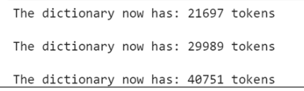
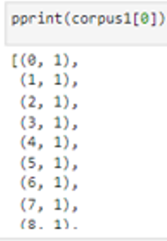
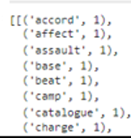
Master Dictionary &
Corpus Creation
Functionality
Output
Master Dictionary creation of all 3 candidate datasets
Dictionary was created which consists of each word after text representing
Corpus creation for
all datasets
Corpus is the mapping of word id to word count in an article
23
23

Slide 24

Topic Modelling
Schematic Flow
24

Slide 25
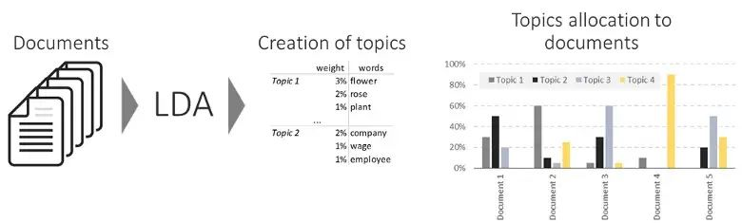
Latent Dirichlet ALLOCATION (lda)
Retrieved from https://www.kdnuggets.com/2019/09/overview-topics-extraction-python-latent-dirichlet-allocation.html
25

Slide 26
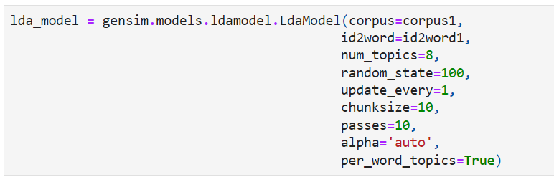
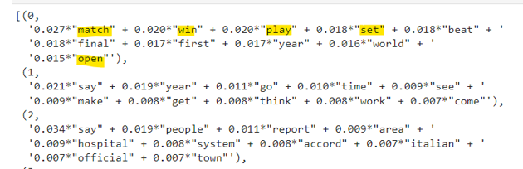
Model Build
Build LDA Model
Input - number of topics, dictionary and corpus.
Identifying dominant topics using the model
Starting with 8 dominant topics, the model provides 10 collections of keywords that occur together as topics
Each keyword has its own weightage in that collection
26

Slide 27

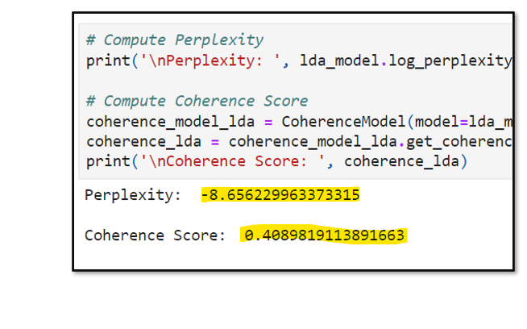
Model Measure Metrics
Coherence
Shows how good the model is
Coherence/Perplexity
Topic Coherence measures the score of a single topic by measuring the degree of semantic similarity between high-scoring words in the topic. “Higher values” of coherence are needed
Perplexity
Measures how well a probability model predicts a sample. ”Lower values” of perplexity are needed
27

Slide 28
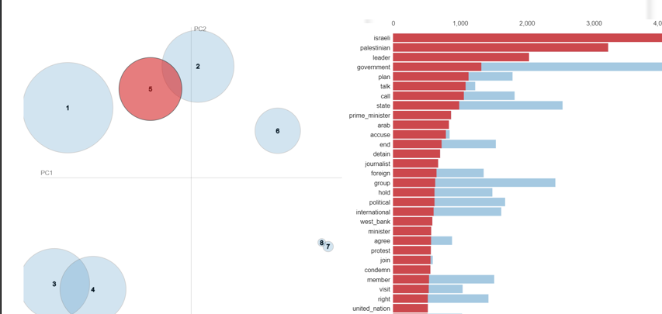

Visualization
Intertopic Distance Map Showing Topic Clusters With Corresponding Keywords
Intertopic Distance Map(via multidimensional scaling
Top 30 Most Relevant Terms for topic 9
28

Slide 29
Model Tuning
Schematic Flow
29

Slide 30
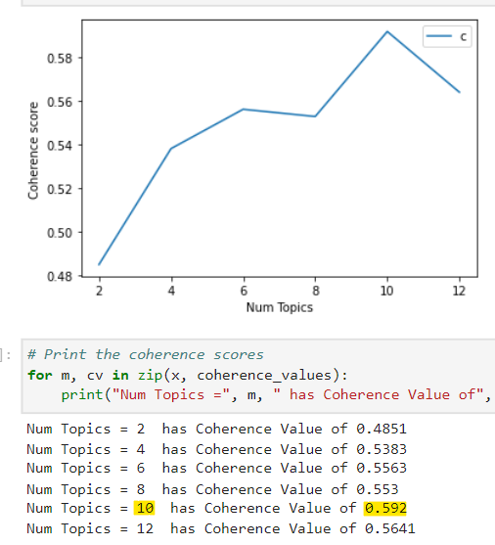
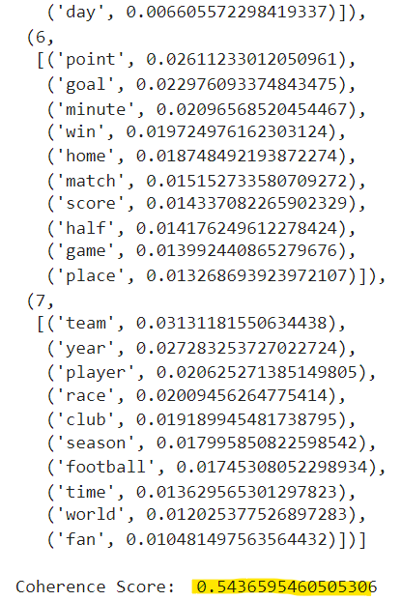
Mallet Model
Building “LDA-Mallet” model for tuning
Identifying the optimum number of topics
Using coherence score
Identifying dominant topics using the model
Optimal No of topics
30

Slide 31
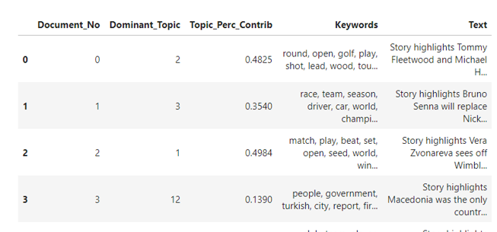
Model with new-found optimal number of topics
Model is run again with the optimum number of topics
The articles in the dataset are classified with the identified topics
31

Slide 32
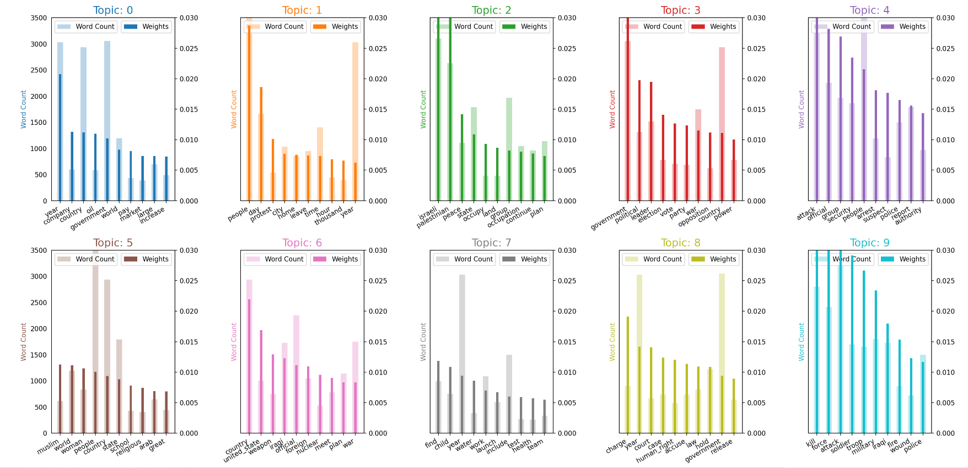

Topic Labeling
Determining the Best Descriptor Tag and Labelling Visualizing
The keywords are displayed as overlapping bar graphs of the
“word count” & their “weights“
Word Count and importance of Topic Keywords
A list is manually created to map topic index to labels
32

Slide 33

Model RESULTS
Aljazeera
BBC
CNN
Japan Times
CNBC
Initial # Of Topics: 8
Coherence score: 0.409 (Gensim LDA)
Coherence score: 0.45 (Mallet LDA)
Optimal # Of Topics:10
Initial # Of Topics: 10
(Mallet LDA)
Coherence score : 0.45
Optimal # Of Topics:8
Initial # Of Topics: 8
(Mallet LDA)
Coherence score: 0.56
Optimal # Of Topics:10
Initial # Of Topics: 10
(Mallet LDA)
Coherence score : 0.34
Optimal # Of Topics:2
Initial # Of Topics: 2
(Mallet LDA)
Coherence score : 0.42
Optimal # Of Topics: 10
New Coherence
New Coherence
New Coherence
New Coherence
0.464
New Coherence
0.451
New Coherence
0.592
New Coherence
0.412
New Coherence
0.464
0.464
0.464
0.464
33

Slide 34
4
GROUPING DATASETS AS COLLECTIONS

Slide 35
Tag packages & catalog loading
Schematic Flow
Model Tuning
Keyword & Text Extraction
Model Training
Topic Modelling LA
35

Slide 36
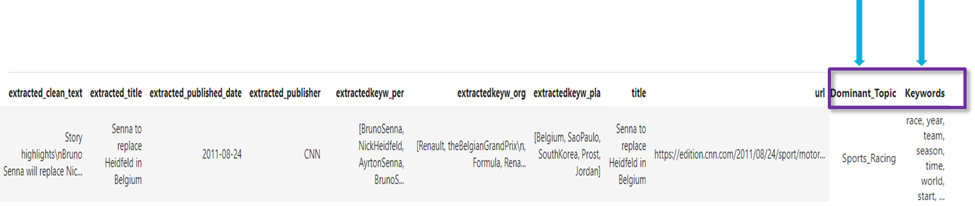
COMPLETELY Tagged DATASET
Adding identified topics to the Datasets for classifying them
36

Slide 37
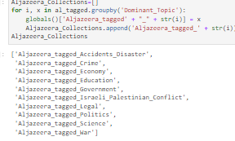

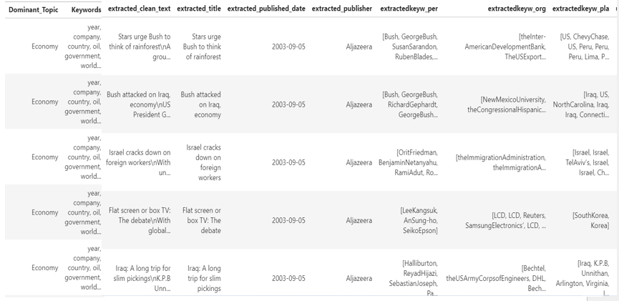
Group Collections as individual data frames
37

Slide 38
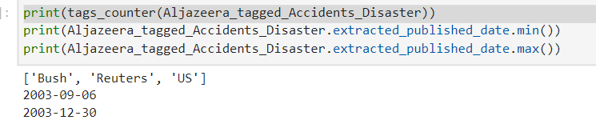
Tag Packages with tag field name
Roll-up collections via keyword frequency and Tag them
38

Slide 39
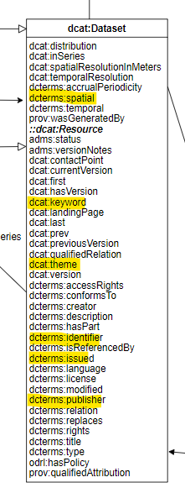

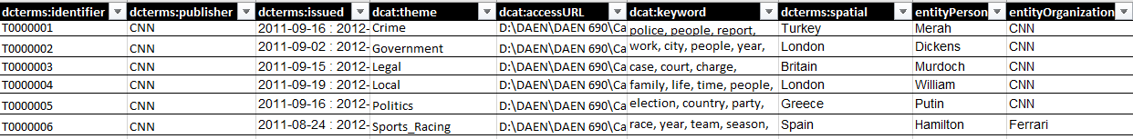
Implementation of DCAT
Data Catalog Vocabulary (DCAT)
Final Tagged Package
39

Slide 40



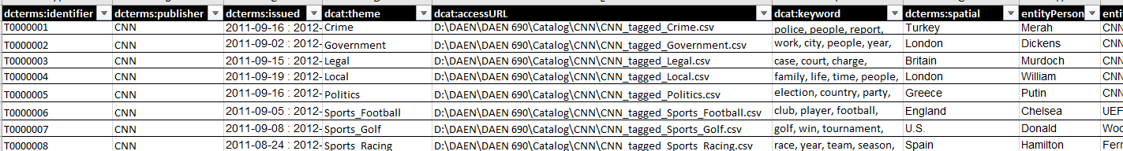
Scenario - "User Queries on the Catalog Search Engine for "Racing + Formula One"
40

Slide 41
5
Conclusion , Lesson Learned
& NEXT STEPS

Slide 42

CONCLUSION
How?
The LDA model was been built to determine the dominating topics from the collection of articles
What we did?
Classified and tagged metadata for collections in the datasets by identifying best descriptor
Result?
A package of tagged data collections prepared to upload to a data catalog
Summary
Developed a pipeline to resolve the problem of manual tagging process beneficial for organizations to catalog their data
42

Slide 43
Lessons Learned
1
Thorough understanding of the Problem Domain with fewer assumptions
Set HARD boundaries for Scope
2
3
Scale solution and analysis based on available resources
Version Control for Code Changes
4
43

Slide 44

Next Steps & Recommendations
Topic indexing automation
Support other languages
Working on the accent encoding
Extending into new areas of expertise
44

Slide 45
Thank you!
Questions?
45

